Slide 1
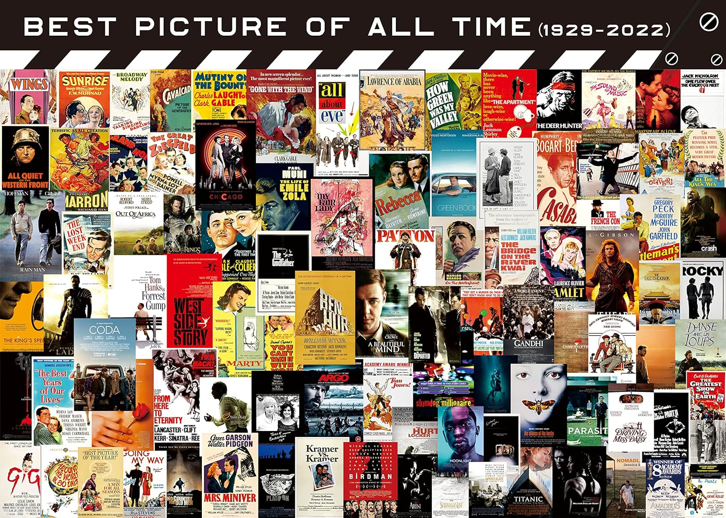
Once Upon a Time in Movie Industry
Social Data Analysis & Visualization
Group 40
Yue Zhou
Yu Zhang

Slide 2

Ideas
Explore the intricate relationship between 'money' and 'movies' from various dimensions, including income and expenditure, as well as various factors that affect the return-to output ratio.
Predict movie revenue from specific indicators.
Classify if a movie will lose money/make a lot of money at the box office?
Visualize a movie recommendation system to help users select the possible high-quality movies based on the TMDB rating indicators.

Slide 3

Why it is interesting?
Economic and Cultural Impact: Understanding the financial dynamics behind filmmaking can provide insights into how movies influence and are influenced by economic conditions, societal trends, and cultural shifts.
Data-Driven Decision Making: Analyzing specific indicators to predict movie revenue can help studios, producers, and investors make better decisions .
Consumer Behavior Understanding: By analyzing what makes a movie financially successful and how audiences' preferences are reflected in TMDB ratings, the industry can gain insights into the evolving tastes and expectations of moviegoers.

Slide 4

Dataset
MovieLens Dataset (consists of movies released on or before July 2017).
33 MB, 45572 rows (That is to say, it includes data for a total of 45,572 movies), 24 variables.
We also introduce several other related dataset like rating, keywords and credits for reference. The total size of all data is approximately 900 MB.
Focus on several key properties such as budget, revenue, genres, original language, popularity, production countries, and others.

Slide 5

Genre
Annotated Chart: Explain and highlight the relationship between various financial aspects (such as revenue and expenses) and their impact on the film, better showing correlations, trends, anomalies, etc.
Partitioned Poster: Dividing the visualization into sections, with each section focusing on a specific factor, can provide a holistic view and a comprehensive overview of the different factors that impact return-to-output ratio.
Scroll Story: To visualize the movie recommendation system, as users scroll, they can see how different TMDB rating metrics affect the recommendation algorithm.

Slide 6
Are you ever curious about...

Slide 7
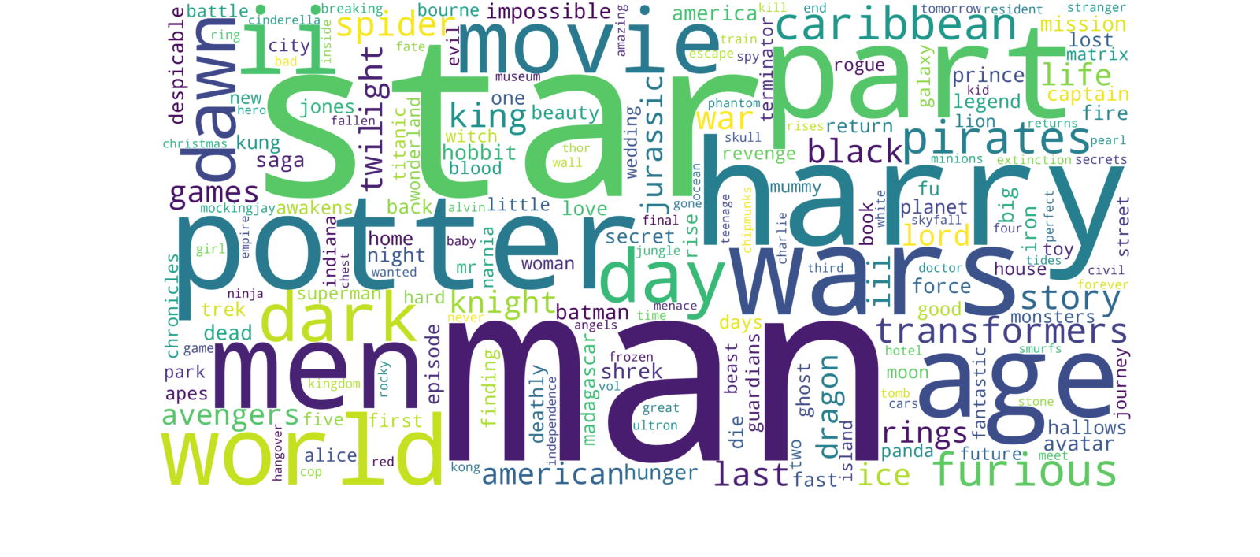
Which words commonly appear in the titles of high-grossing movies?

Slide 8
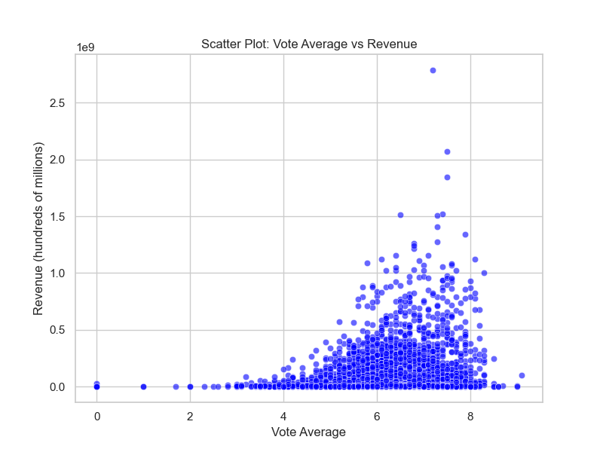
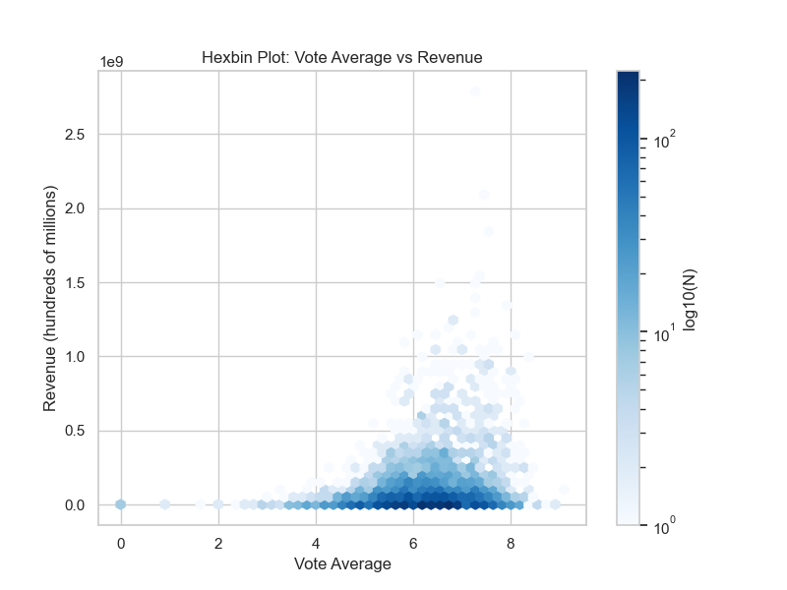
Do the most commercially successful movies always receive higher ratings?

Slide 9
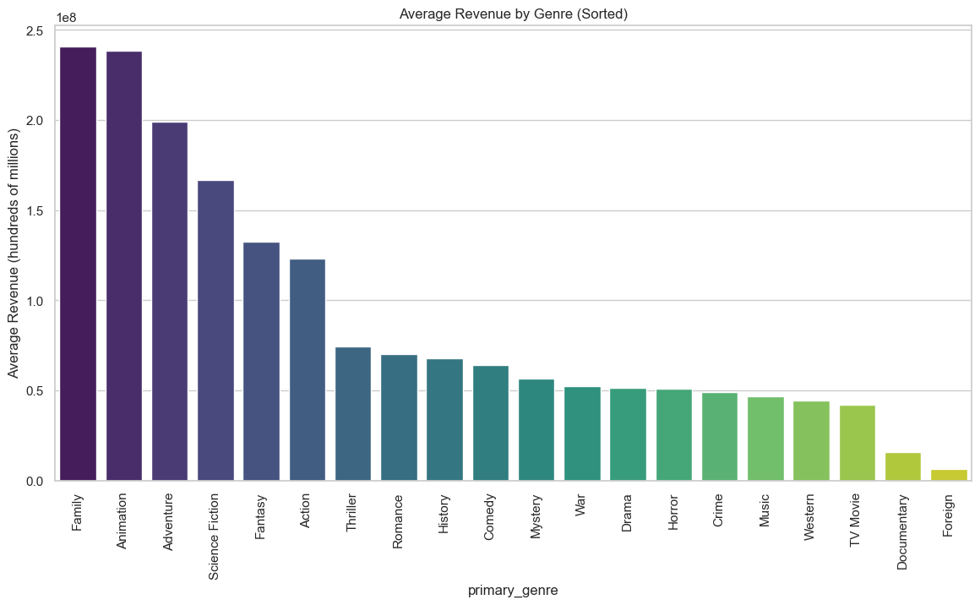
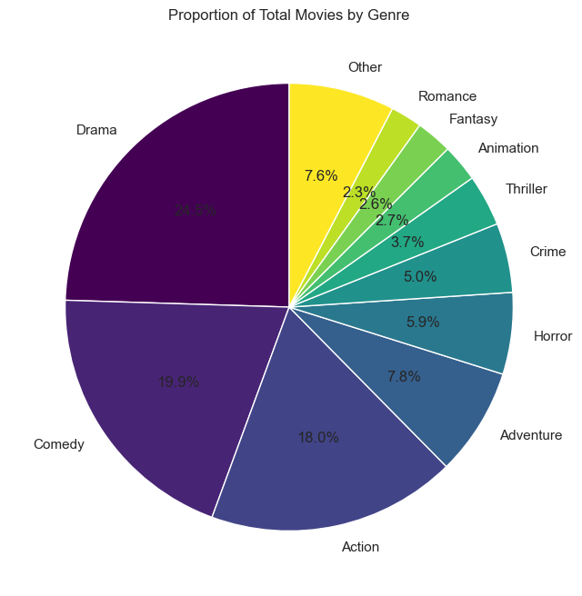
Which genre of movies is the biggest box office winner?

Slide 10
More to come…
Thanks for watching!

